Slide 1
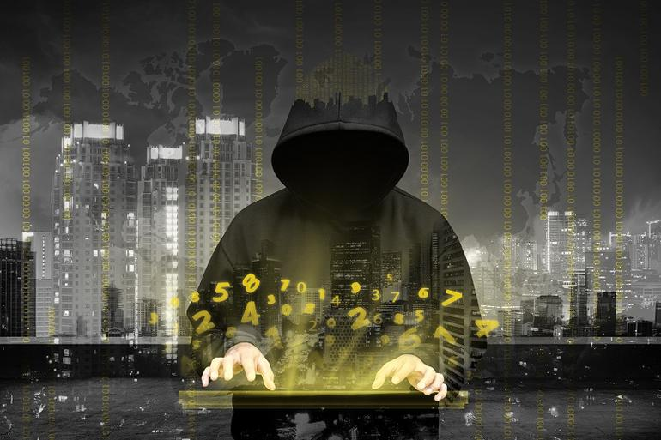
Cyber Security Threats 2017
CloudNexus and First Resource Insurance Group
February 2017

Slide 2

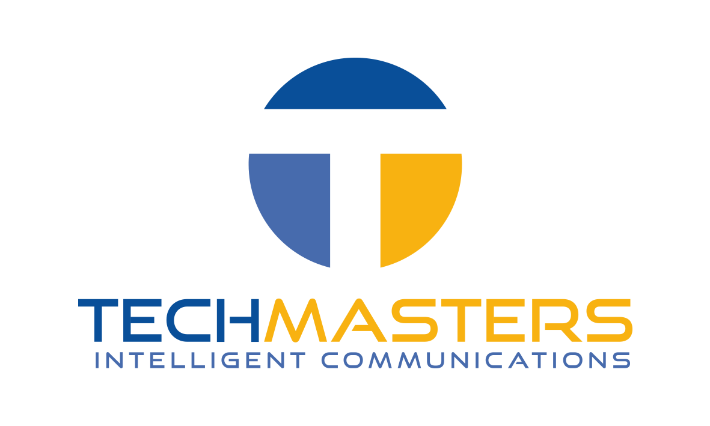

Principium Technologies, LLC | Founded in 2010
IT Managed Service Provider | http://www.principiumtech.com
Jay Rollins, CEO
502-440-1380 | jay@principiumtech.com
TechMasters, LLC | Founded in 2015
VoIP Phone Systems | http://www.techmastersky.com
Jay Rollins, CEO
502-440-1380 | jay@techmastersky.com
+
=

Slide 3
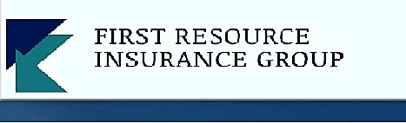
Christopher Green
First Resource Insurance Group
http://www.frigroupinc.com/
9900 Corporate Campus Drive, Suite 3000
Louisville, KY 40223
Tel: 502-657-6320
Fax: 502-657-6321
cgreen@frigroupinc.com

Slide 4
Cybersecurity Outlook 2017
Almost one in five small business owners say their company has had a loss of data in the past year. Small business owners are particularly hurt by cyberattacks. According to recent data 63 percent of small business owners view data as their new currency, and that a single data hack could have associated costs ranging from $82,200 to $256,000.
- Norman Guadango, Carbonite

Slide 5
Hackers: Breaches
Headlines
  Ashley Madison 2015: Many use same passwords, spear phishing campaigns, blackmail targets
  Twitter: 32 Million
  Yahoo: 500 Million (LinkedIn, Amazon, Facebook, Credit Cards, )
  Security cameras, breachable appliances, access control systems
  Malware found on all platforms including Apple
  2 million new signatures of malware in July 2016

Slide 6
Cyber Security Threats for 2017
Ransomware and Extortion will increase (Stephen Gates, NSFocus)
Industrial IoT attacks will increase (Adam Meyer, SurfWatch)
Internal Threats will increase (James Maude, Avetco)
Physical Security Investments (Ed Solis, CommScope)
Hackers are in the Long Game
Notes:
As more devices become internet-enabled and accessible and the security measures in place continue to lag behind, the associated risks are on the rise. Aside from the obvious risks for attacks on consumer IoT devices, there is a growing threat against industrial and municipal IoT as well. As leading manufacturers and grid power producers transition to Industry 4.0, sufficient safeguards are lacking. Not only do these IoT devices run the risk of being used to attack others, but their vulnerabilities leave them open to being used against the industrial organizations operating critical infrastructure themselves. This can lead to theft of intellectual property, collecting competitive intelligence, and even the disruption or destruction of critical infrastructure. Not only is the potential scale of these attacks larger, most of these industrial firms do not have the skills in place to deal with web attacks in real-time, which can cause long-lasting, damaging results. This alone will become one of the greatest threats that countries and corporations need to brace themselves for in 2017 and beyond.
There are plenty of "As-A- Service" attack capabilities on the Dark Web for hire now and we should expect creative new IoT hack services to pop up in the near future.
As organizations adopt more effective strategies to defeat malware, attackers will shift their approach and start to use legitimate credentials and software - think physical insiders, credential theft, man-in-the-app. The increased targeting of social media and personal email bypasses many network defenses, like email scans and URL filters. The most dangerous aspect is how attackers manipulate victims with offers or threats that they would not want to present to an employer, like employment offers or illicit content. Defenders will begin to appreciate that inconsistent user behaviors are the most effective way to differentiate malware and insider threats from safe and acceptable content.

Slide 7
Attack Vectors
Hacking (Data theft, corporate espionage, identity theft)
Social Engineering (Spear Phishing, Phishing, traditional SE)
Internal attacks: Unauthorized access and access control
Cloud Attacks and Breaches (Dropbox, iCloud, OneDrive, Etc.)
Virus/Malware/Botnet
Ransomware and Extortion

Slide 8
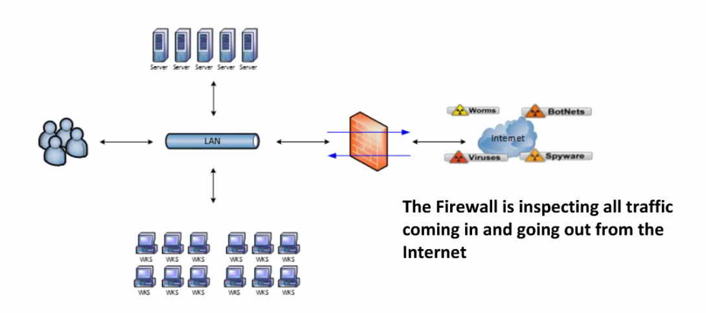
Legacy Gateway Security Implementation

Slide 9
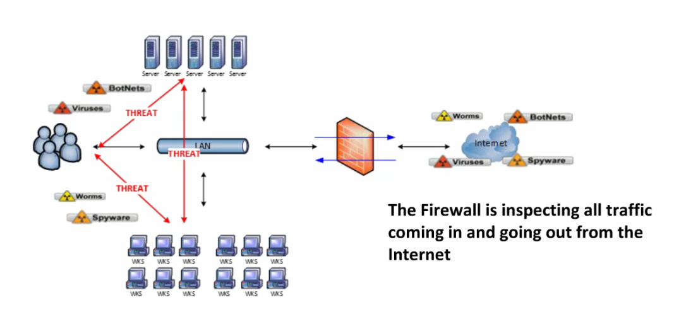
Modern Security Implementation

Slide 10
Cyber Security Focus
Keeping the Bad Guys out
Protecting your Internal Network
Recovering from an Attack

Slide 11
Business Security: Keep the bad guys out
Tools
  Modern firewall
  Security Event Manager
  Spam Filter
Policy
  Monitor 24x7
  Security Event and Log Review
  No local Admins!
  Patch Management and Passwords (2 Form Factor)

Slide 12
External Threat Strategy
Raise the bar higher than the next guy
Weigh what you automate with what you control through policy and procedure
Higher priced experts in most cases are cheaper than the alternatives
Constant education on the latest threats must be a priority. The best defense is intelligence.

Slide 13
Business Security: Protect from the Inside
Tools
  Anti-virus, Anti-Malware
  Security Event Manager
  Modern Firewall
  Reverse Spam Filter
  Network Design: Zones (Lessons from Pearl Harbor)
Policy
  Employee Training
  Data Retention, Email Security, Data Access and Access Control policies
  Employee Turnover
  Device Management

Slide 14
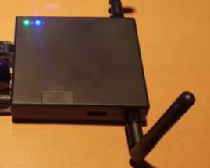
Importance of Training
Free Wifi: Device called wifi pineapple mimics popular banking websites.
Pass through pineapple to whatever sites they want and capture user names and passwords. Slowly add botnets, malware and virus.
USB drives “dropped” 30 drives, 67 different networks including corporate networks
Waterhole attacks: redirect to compromised websites
Spear Phishing: Cost one firm $47 million (CEO email wire transfer)

Slide 15
Business Security: Attack Recovery
Tools
  Backup, Disaster Recovery and Business Continuity
  Cyber Security Insurance
Policy
  Communication Plan
  Recovery Time Objective
  Recovery Point Objective
  Incident Source Identification and Quarantine
  Test, Test, Test

Slide 16
Recovery Considerations
Attack Source Discovery: 5 minutes to 8 hours
Systems Restoration: 20 minutes to 2 weeks
Data Loss: 15 minutes to 24 hours
Put a real cost to the business loss to truly understand the impact
  Salary
  Missed sales
  Lost data
  Project delays and associated opportunity cost

Slide 17
Warning!!!
Tech Speak Coming!

Slide 18
Firewall Evolution
Packet Inspection: Traffic cop: Can see car, color, plate, make and model and which direction it is coming from but cant see who is driving, what is in the trunk, what is underneath the car
Deep Packet Inspection: X-ray vision. Much better than Packet Inspections but even Superman can’t see through lead
Encrypted traffic: https traffic is major cause of most breaches. Google prioritizes search results to list https. Ransomware Cryptolocker uses this to explode on a network via webmail
Firewall purchased in the past 18-36 months may not be able to inspect https traffic

Slide 19

Security Quick Tips
Move DNS to trusted DNS source only
Restrict outbound VPN connection to trusted users (Ransomeware Call Home)
Block outbound SMTP (Botnet Zombies)
Restrict outbound SSH connectivity (Remote access Trojan)
Restrict download of executable files to admins and trusted users
Inspect encrypted traffic
Two factor authentication for remote users
Block illicit applications (proxy bypass, peer to peer, tor, etc.)
Automate alerts and review network traffic frequently

Slide 20
What We Provide
Fully Managed Cyber Security Service
Annual Penetration Testing
Secure Network Design Services (HIPAA, FINRA and PCI)
6th Generation Managed Security Appliance
Cloud-based EWS (Early Warning System)
End-Point protection
Spam protection
Patch Management
Backup, Disaster Recovery and Business Continuity Appliance and Service
24x7 Expert monitoring and remediation services

Slide 21
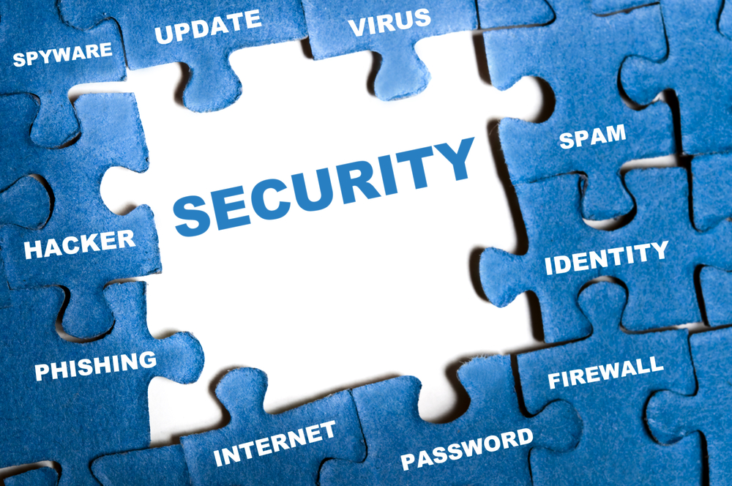
What We Provide
Comprehensive Cyber Insurance Coverage
Customized to Meet the Needs of your Business
Policy Limits Ranging from $50K - $1M
Coverage I – Response Expense
Coverage II – Defense and Liability

Slide 22
Cyber Insurance Coverage’s
1st Party Coverage’s
Breach Response Costs, Notification Expenses, Credit Monitoring
Network Asset Protection
Cyber Extortion
Cyber Terrorism
Identity Theft Expense Coverage
3rd Party Coverage’s
Multimedia Liability Coverage
Security & Privacy Liability Coverage
Privacy Regulatory Defense & Penalties

Slide 23

Thank You!
Chris Green
502-657-6320
cgreen@frigroupinc.com
Jay Rollins
502-440-1380
jay@principiumtech.com

